Slide 1
CYCLISTIC CASE STUDY
GOOGLE ANALYTICS CAPSTONE
BY VINZ MONTILLA
MAY 2023

Slide 2
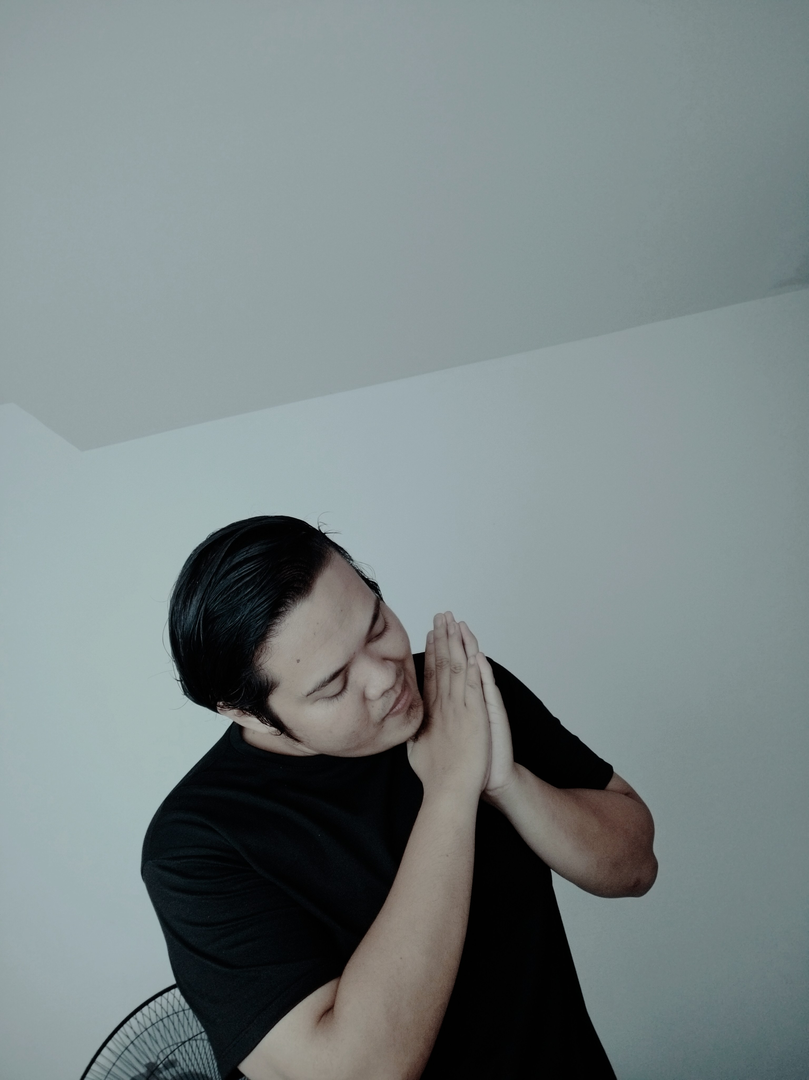
HELLO!
I am Vincent Montilla
BS in Computer Science
Aspirant Data Analyst
Github: github.com/vzmontilla
Linkedin: linkedin.com/in/vzmontilla
Email: vinzmontilla31@gmail.com

Slide 3
BACKGROUND
In 2016, Cyclistic launched a successful bike-share offering. Since then, the program has grown to a fleet of 5,824 bicycles that are geo-tracked and locked into a network of 692 stations across Chicago.
Until now, Cyclistic’s marketing strategy relied on building general awareness and appealing to broad consumer segments. One approach that helped make these things possible was the flexibility of its pricing plans: single-ride passes, full-day passes, and annual memberships. Customers who purchase single-ride or full-day passes are referred to as casual riders. Customers who purchase annual memberships are Cyclistic members.

Slide 4
CASE STUDY
Support the decision-making process behind the supporting or opposing a marketing strategy that attempt to convert CASUALS into MEMBERS

Slide 5
THE PROBLEM
How do the MEMBERS and CASUAL riders use Cyclistic bikes differently?

Slide 6
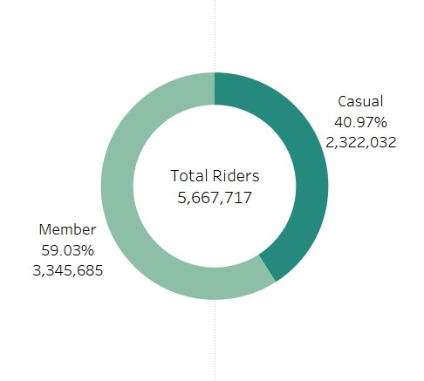
OVERALL RIDERS
Total of 5,667,717 riders in 2022

Slide 7
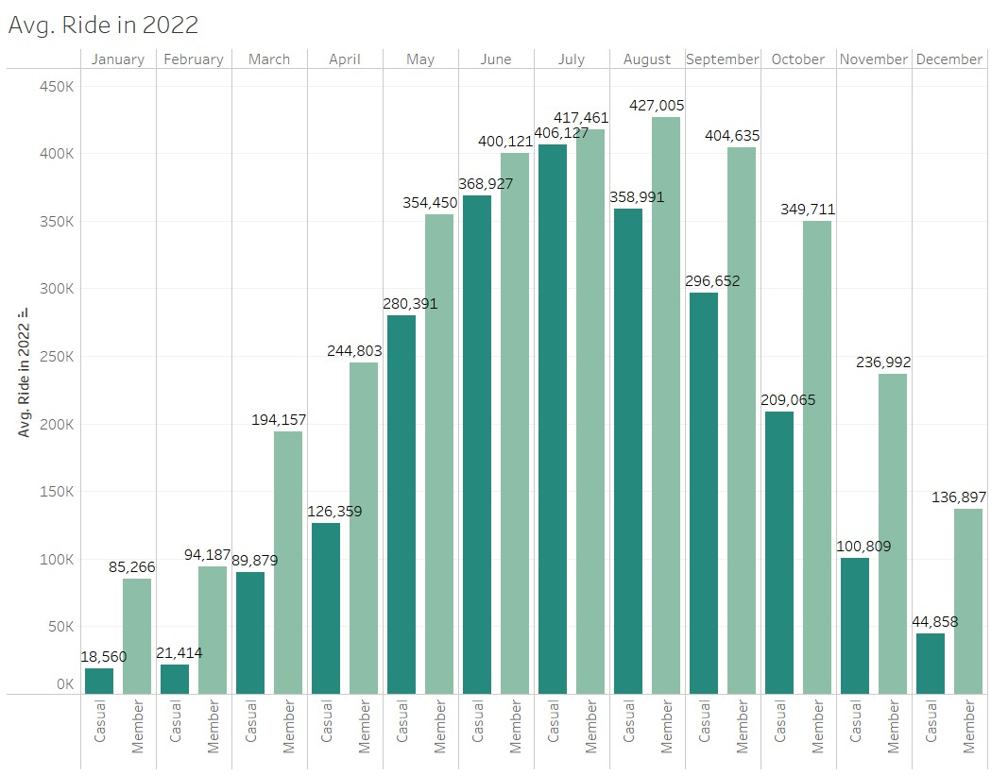
MONTHLY RIDERS
Busiest Month was July – 823,588
Slowest Month was January – 103,826

Slide 8
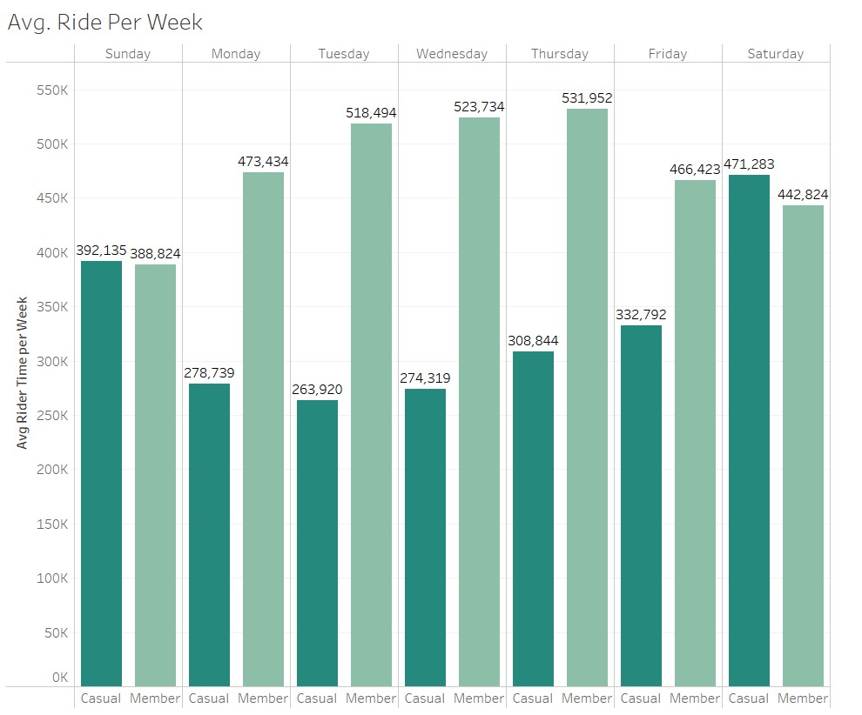
DAILY RIDERS
MEMBERS ride more on during weekdays.
CASUALS ride more on weekends.

Slide 9
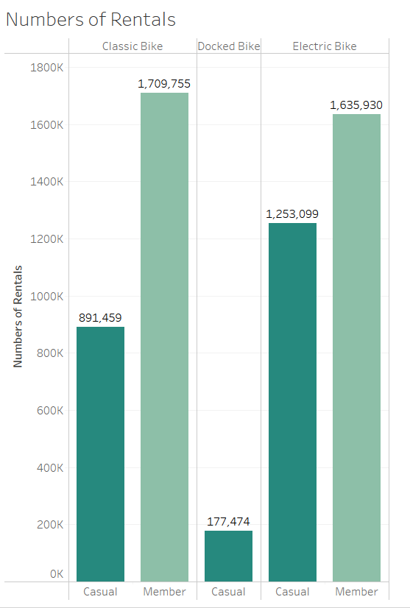
NUMBERS OF RENTALS
You can see the popular bikes that
MEMBERS and CASUALS that they use.

Slide 10
KEY FINDINGS: SUMMARY
Members and Casual tended to ride more on the months of July and August.
To further that the Casual demographic spent on average a lot longer time per ride than their long-term counterpart.
The days of the week also further shows that MEMBER riders typically utilized the service throughout the weekdays work. Aside the CASUAL riders prefer to the use service during the weekends.
The Member and Casual riders tended to use more on the Classic Bike and Electric Bike. But the Member didn’t used the Docked Bike, while the Casual still used the Docked bike but lower average than the other bikes.

Slide 11
RECOMMENDATIONS
Us we can see the Casual is more appealing in the months of July and August or we say Summer. This Advertising or marketing to the casual need to be done by months od December and January or Winter months.
In the Summer season we need to target the Casual to convert their membership or to market them by giving some discount rates. So that they can much ride on weekdays.
We can also give to the casual riders a referral reward, seasonal discount so that in the demographic we can see the result specially on weekdays.

